Slide 1
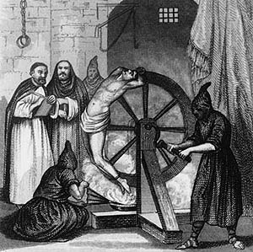
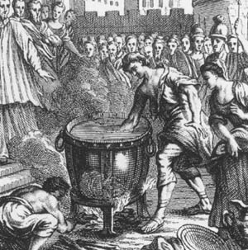
Were the Normans nasty?
Norman crime, law, law enforcement and punishments
What can you learn from these sources about Norman punishments?
The Anglo-Saxon Chronicle for 1139
They [the Normans]hanged them by the thumbs, or by the head, and hung fires on their feet; they put knotted strings about their heads, and writhed them so that it went to the brain ... Some they put in a chest that was short, and narrow, and shallow, and put sharp stones therein, and pressed the man therein, so that they broke all his limbs ... I neither can nor may tell all the wounds or all the tortures which they inflicted on wretched men in this land.

Slide 2
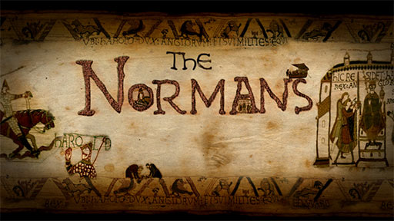

Learning Objectives
To select and deploy information and sources in order to judge whether Norman law and order was nasty
Describe (L2)
Explain (L3)
Judge (L4)

Slide 3
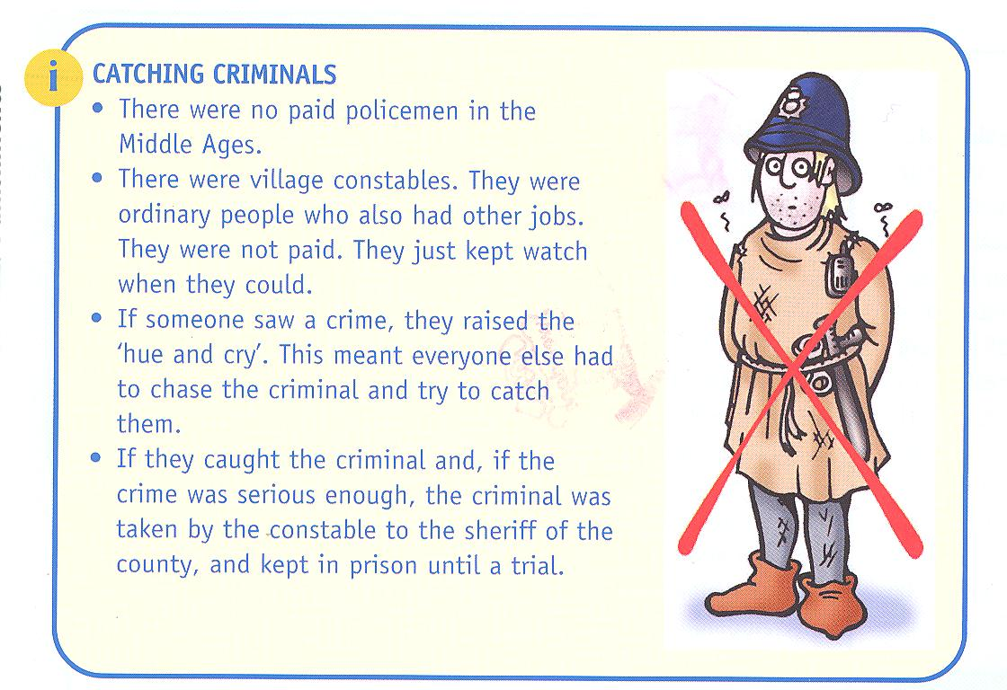
Law Enforcement

Slide 4
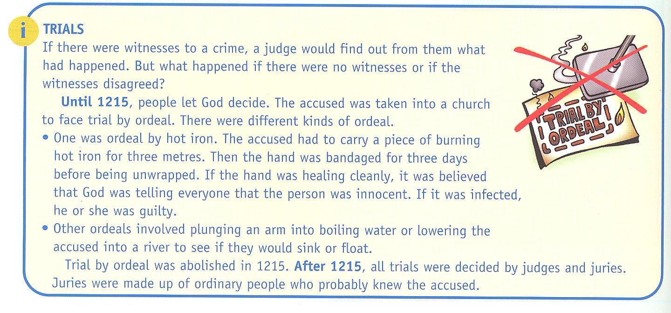
Trials

Slide 5
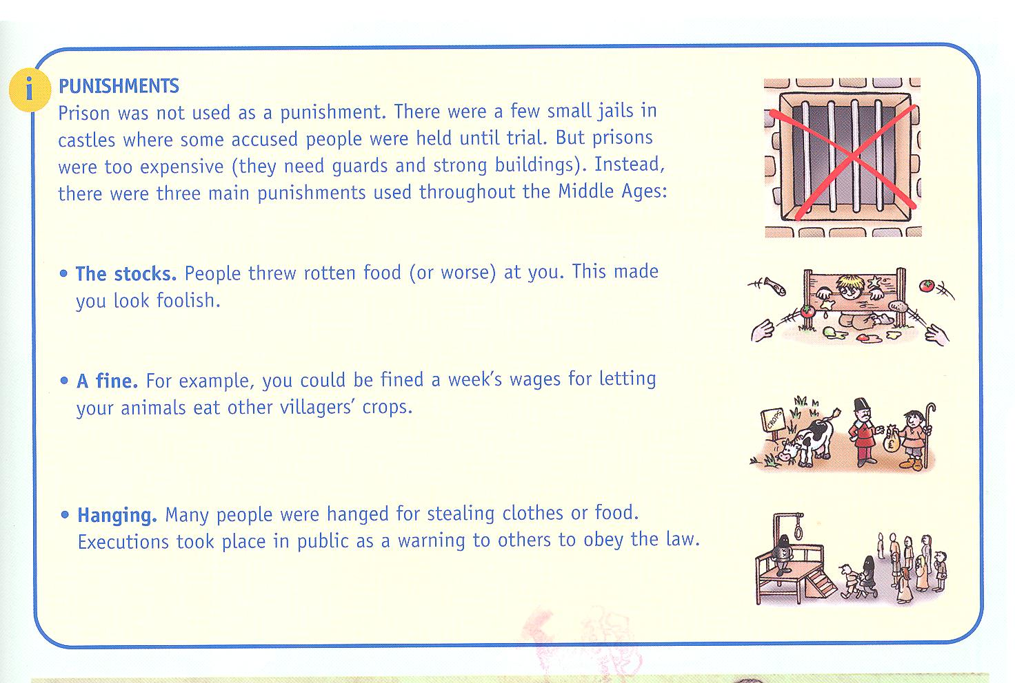
Punishment

Slide 6
New Information/Construct
In groups of 4 investigate Norman crimes, laws, law enforcement and punishments using the information and sources below:
Pages 20-25 in the Folens C&P
Pages 66-68 in Green Todd book C&P
Pages 32-33 white SHP C&P
Pages 27-29 Blue Todd C&P

Slide 7
Apply/Demonstrate learning
Put together your information and evidence in a presentation to show your thoughts about whether the Normans were nasty.
Choice of presentation? A script, sugar paper, song, rap, A3 poster, poem?
Pages 20-25 in the Folens C&P
Pages 66-68 in Green Todd C&P
Pages 32-33 white SHP C&P
Pages 27-29 Blue Todd C&P
Describe (L2)
Explain (L3)
Judge (L4)

Slide 8
Stretch and challenge
What similarities and differences can you find between Norman crime, law, law enforcement and punishments in the Norman times and today?
Can you compare with the Roman and Anglo-Saxon periods?
Notes:
Underline relevant information about crime and punishment in each source. Use a red pen for crimes and blue for punishment.

Slide 9
Success Criteria
You need to establish your success criteria in order to make your presentation …you’ve guessed it…successful!
Historical details
Use of evidence
Focus on all 4 areas
Describe/explain/judge
Persuasion
Presentation
Successful group work
Change/continuity with the past and now

Slide 10
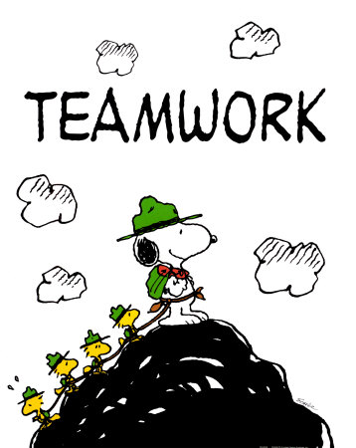
Effective Group work
Agree what the task is about (talk together to decide what the outcome will be)
Talk through and decide a way forward (discuss and make decisions)
Work together to complete each part of the task (focus and cooperate)
Review your work (how well have you done?)

Slide 11
Review and reflect
Share presentations to reach a judgement.
Discuss and compare with the findings of the other groups.
Nice
Nasty
Normans
Don’t forget to justify (give a good reason for your judgement)!
Notes:
Underline relevant information about crime and punishment in each source. Use a red pen for crimes and blue for punishment.

